Slide 1

Summer Internship FINAL Review
- Kiran Patil

Slide 2
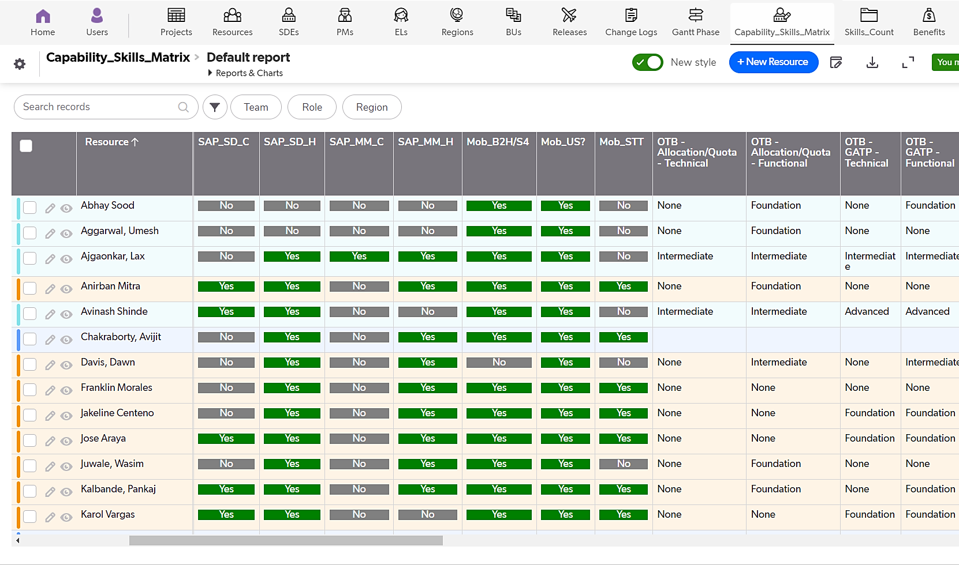


Project 1: Capability Skills Matrix (NCLC)
​
Description :To stay competitive in the industry We need Recourse capability skills matrix with their proficiency level.
Objective : ​
​​Team Skills Repository
Identify skill gaps.
Outcome: ​
Build an App that will enable resource capture, Skills Summary & Proficiency.
Benefits :
​Identify & understand specific skill gaps, individual learning interests within the team.
Better allocation of the resources
​Current Status:
Completed.

Slide 3
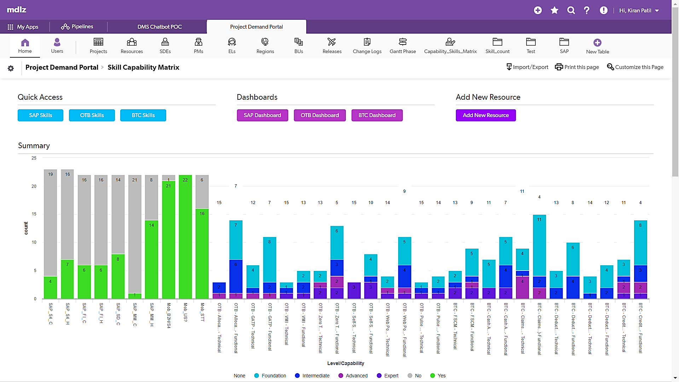

Project 1: Capability Skills Matrix (NCLC)

Slide 4
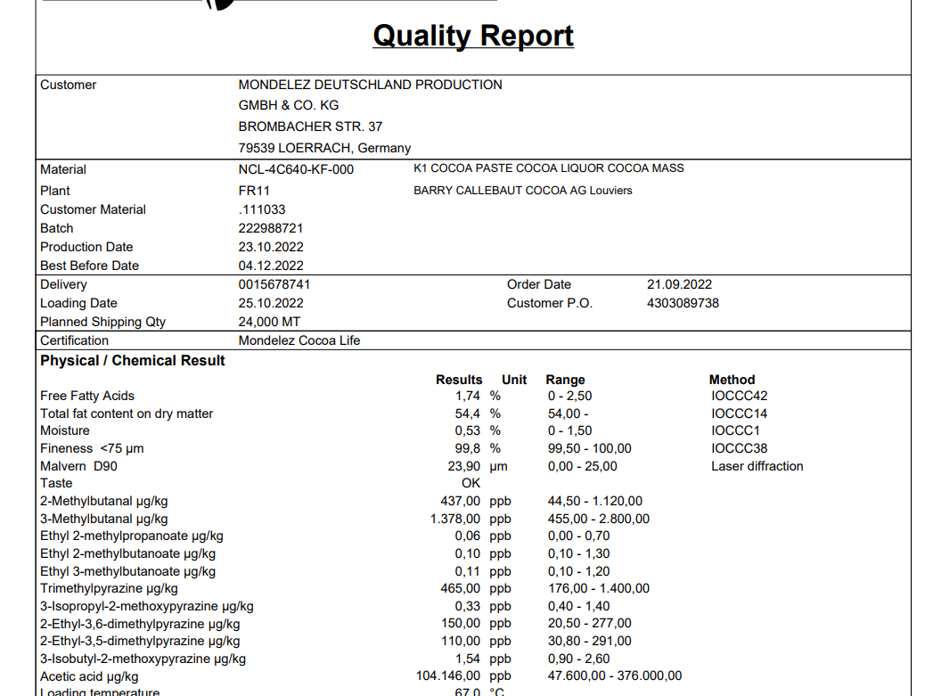
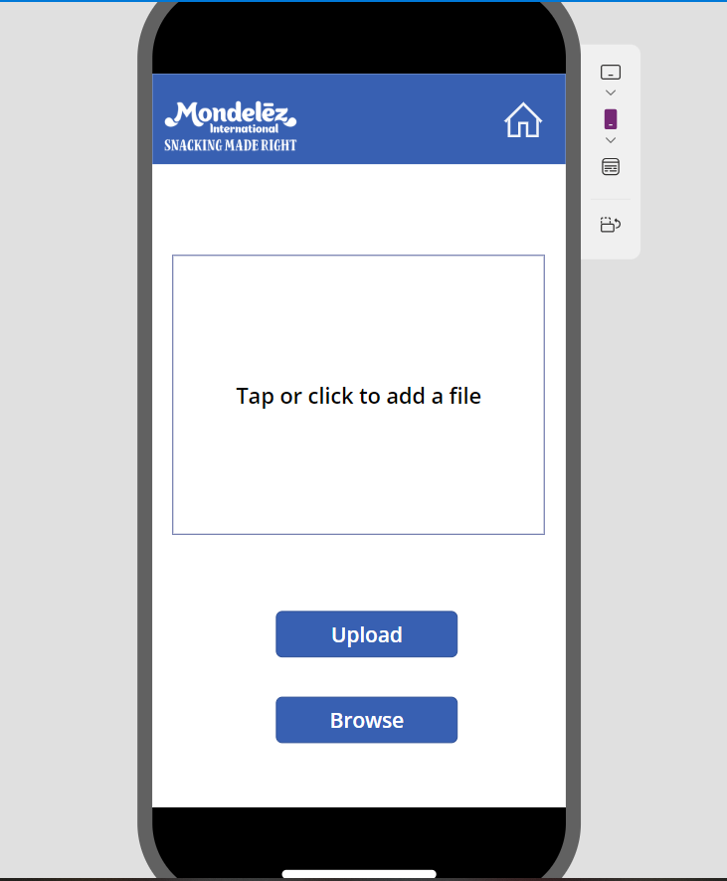
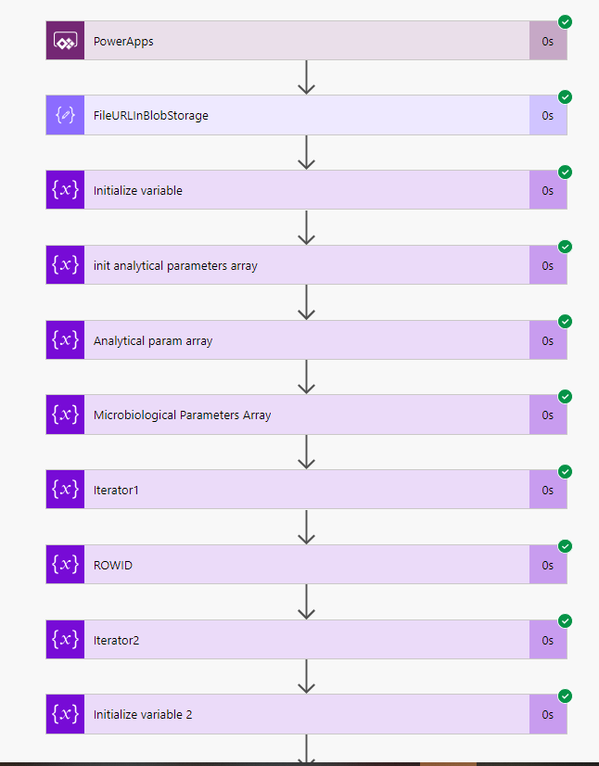
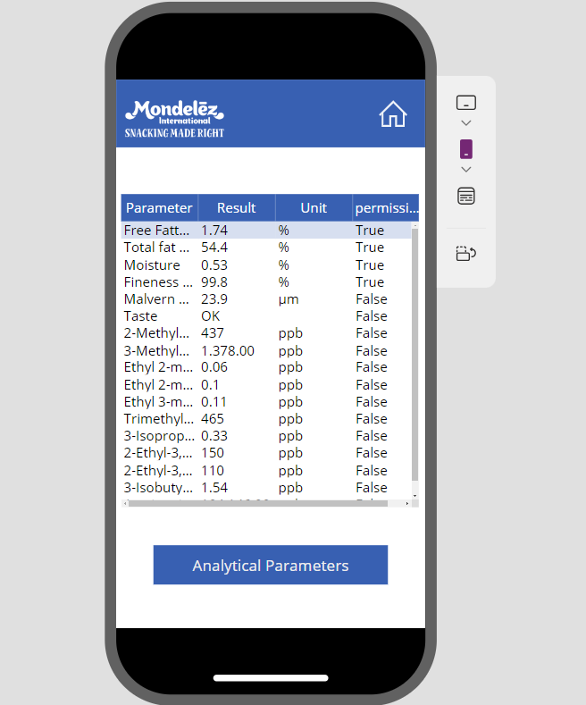




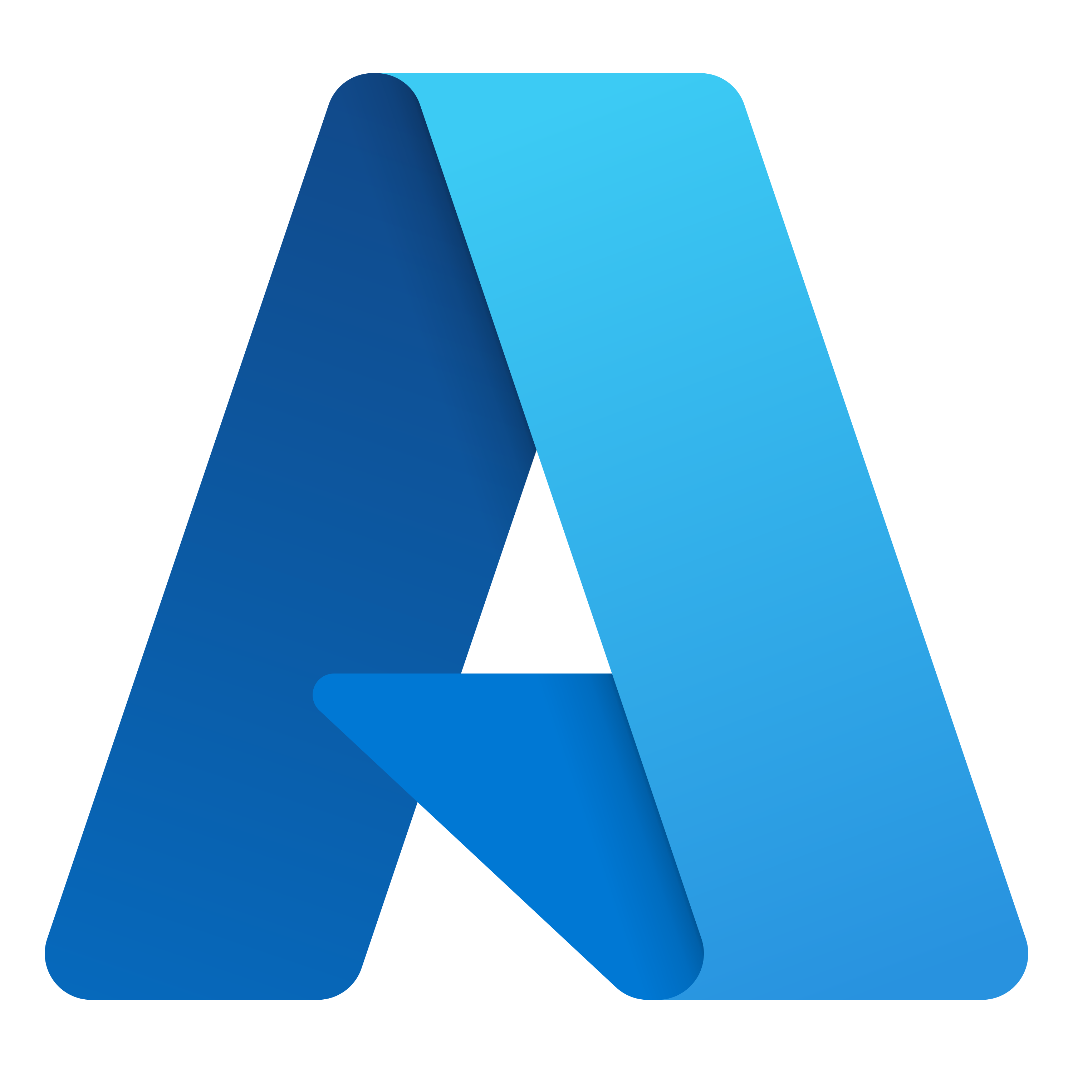
Project 2: AUTOCOA POC ( NLP )
Description : The raw material provider come up with COA’s along with material and the quality analysis team manually verify it with master data whether its parameters are permissible or not
Objective :
Automate the process of COA of raw material to be used across all the regions.
​Outcome: ​
Automate COA process
Save time and efforts and cost.
​Current Status:
Completed the power automate flow
Built a PowerApp and integrated them.
The POC is completed. To be reviewed and approved by ARB.
Project 2: AUTOCOA POC (NLP)
Azure AI services
Form Recognizer

Slide 5
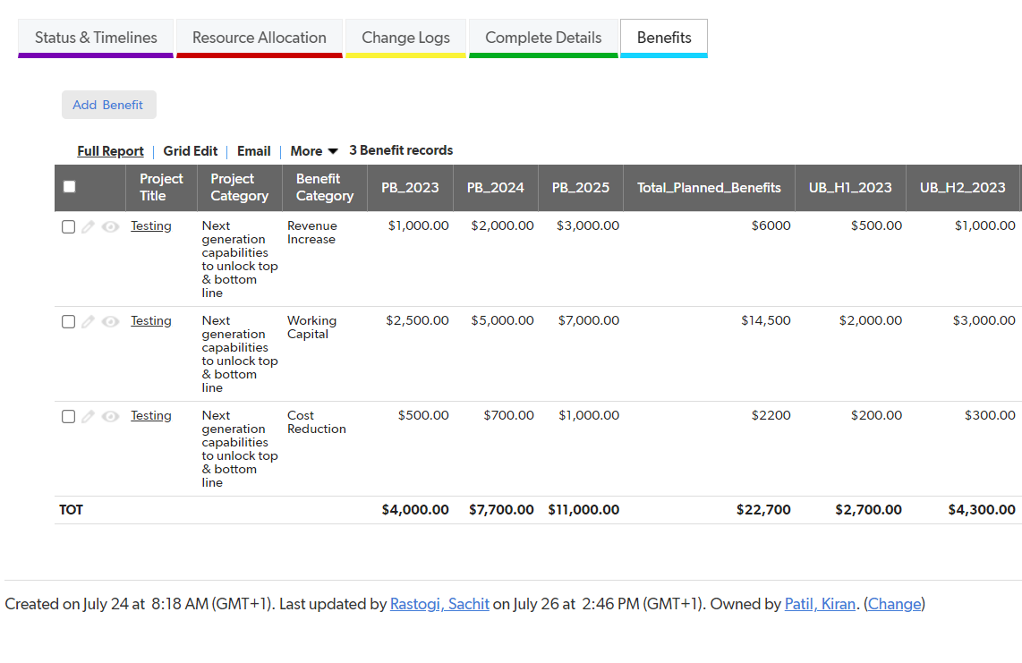
Project 3: BENEFITS TRACKING (NCLC)
Description : There are various projects going on we track them into the Demand tool also wanted to track benefits of these projects.
Objective: ​
To enhance the demand tool to capture the value and benefit
Benefits :
Better capture the value and benefit
Performance Evaluation
Continuous improvement
Risk Management
​Current Status:
Completed.
Project 3 : Benefits Tracking

Slide 6
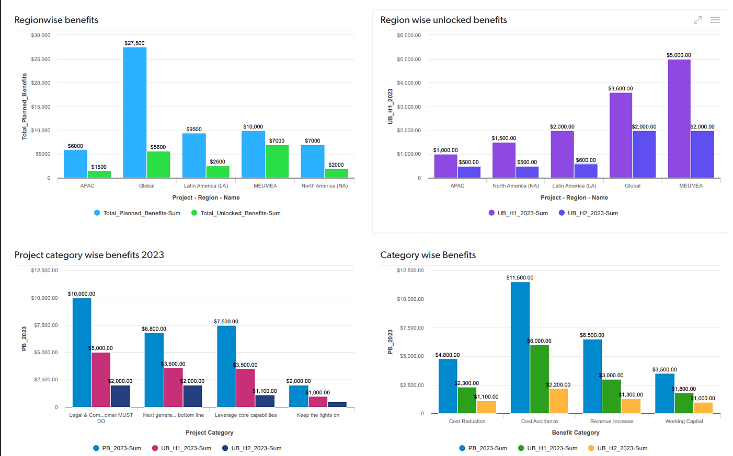
Project 3: BENEFITS TRACKING (NCLC)
REPORTING OF BENEFITS

Slide 7
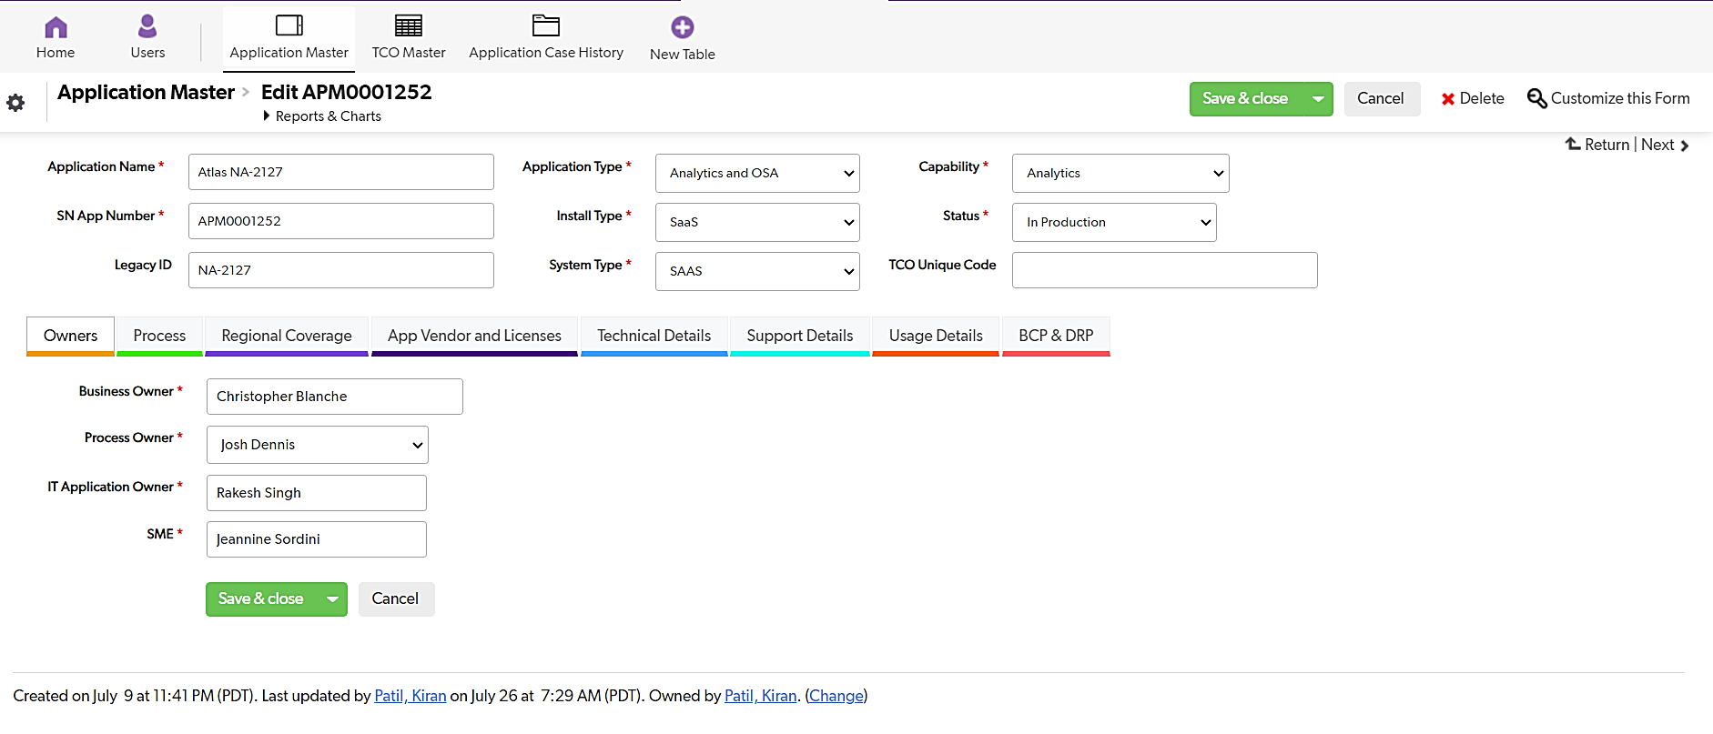
Project 4: TCO Application (NCLC)
Description :
TCO is an app to store and track all Applications, Purchase Orders, Vendor details, and other relevant details.​
Objective: ​
To simplify the process and move away from the conventional excel based tracking.
Benefits :
Improved efficiency, Better data management.
Mobility
​Current Status:
Completed.
Project 4 : TCO App

Slide 8
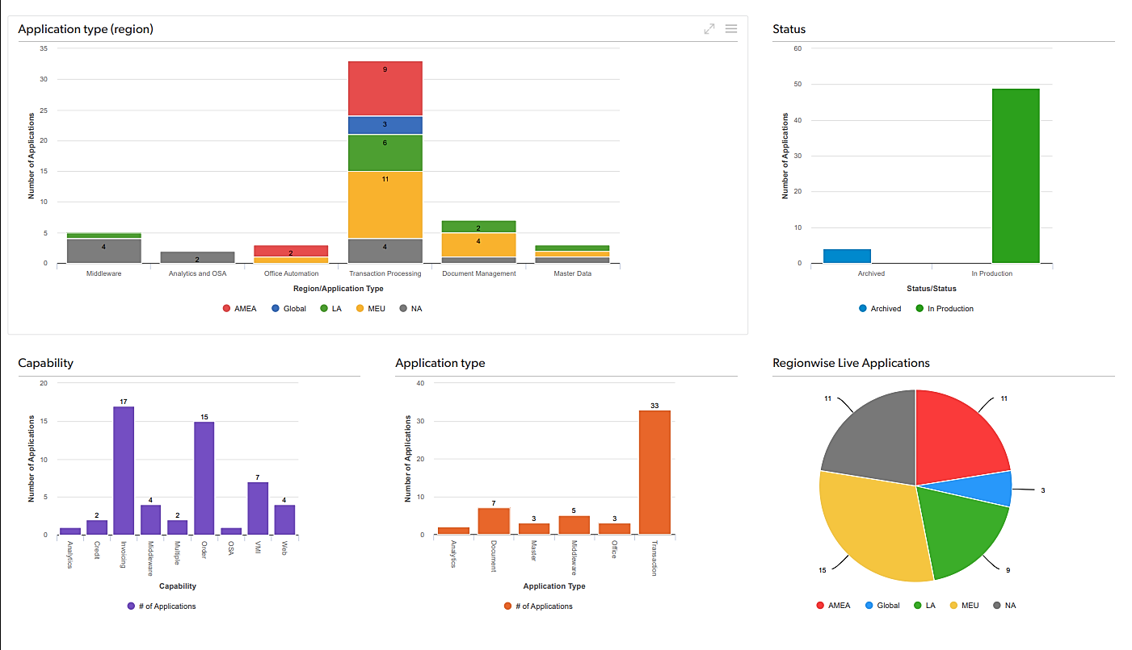
Project 4: TCO Application (NCLC)
TCO App Dashboard

Slide 9
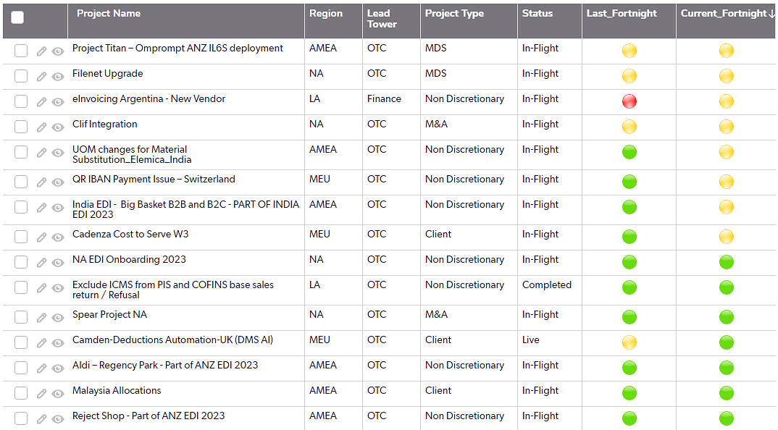
Project 5: Project Reporting app (NCLC)
Description : ​
Automate Graphs and Issue summary generation from weekly status table on Quick base .
Objective : ​
To assess the weekly status of live and in-flight projects with the help of various graphs visually with a help of dashboard.
Benefits :
It's time saving and gives us real time insights with the help of enhanced data visualization and results into increased productivity.​
​Current Status:
Completed.
Current Fortnight vs Last Fortnight

Slide 10
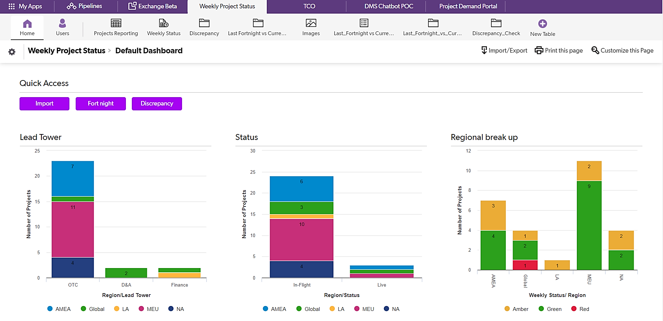
Project 5: Project Reporting app (NCLC)
Project Reporting App Dashboard

Slide 11
Learnings & stakeholders
Learnings
Corporate Experience
Collaboration
Adaptability
Dealing with complexity
Practical Application
Teamwork
Stake Holders
Manoj Biwalkar​
Michele Bright
Lax Ajgaonkar
Sachit Rastogi​
Avinash Shinde​
Amol Bhivarkar
Prachi Tiwari
​
Support/Comments
Appreciate my manager's constant supports and efforts to arrange for regular check-ins and connect to discuss any challenges that I may be facing, seek guidance and receive timely feedback and suggestions on my work. .
I had really enjoyed my time at Mondelez. It was a fantastic learning experience that I will cherish and hope I will get a chance to come back here again.

Slide 12
Thank you!

